Slide 1




INDIAN GEOTECHNICAL SOCIETY
STUDENT CHAPTER TKMCE

Slide 2

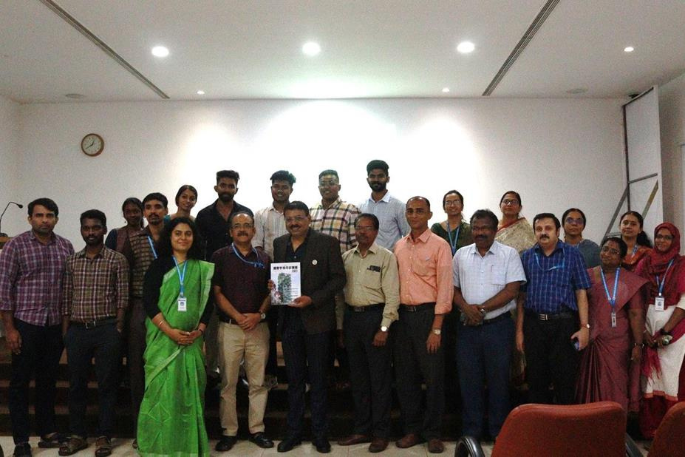
ABOUT IGS
The Indian Geotechnical Society (IGS) aims to promote collaboration among engineers and scientists to enhance and disseminate knowledge in the fields of Soil Mechanics, Foundation Engineering, Soil Dynamics, Engineering Geology, Rock Mechanics, Snow and Ice Mechanics, and related fields, including their practical applications. The IGS serves as a shared platform for researchers, academicians, designers, construction engineers, equipment manufacturers, and others interested in geotechnical activities.

Slide 3
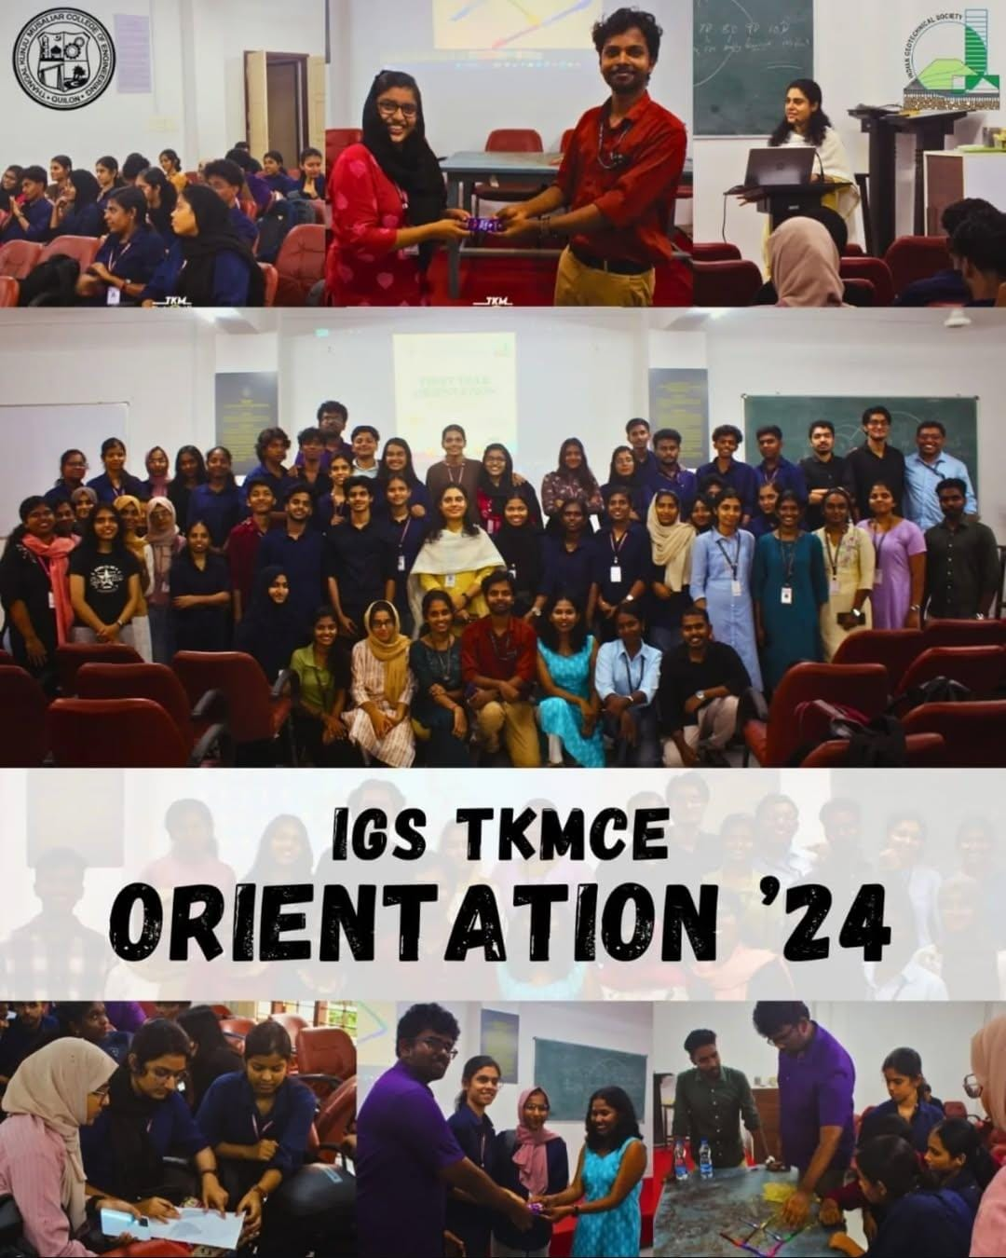
FIRST YEAR ORIENTATION

Slide 4
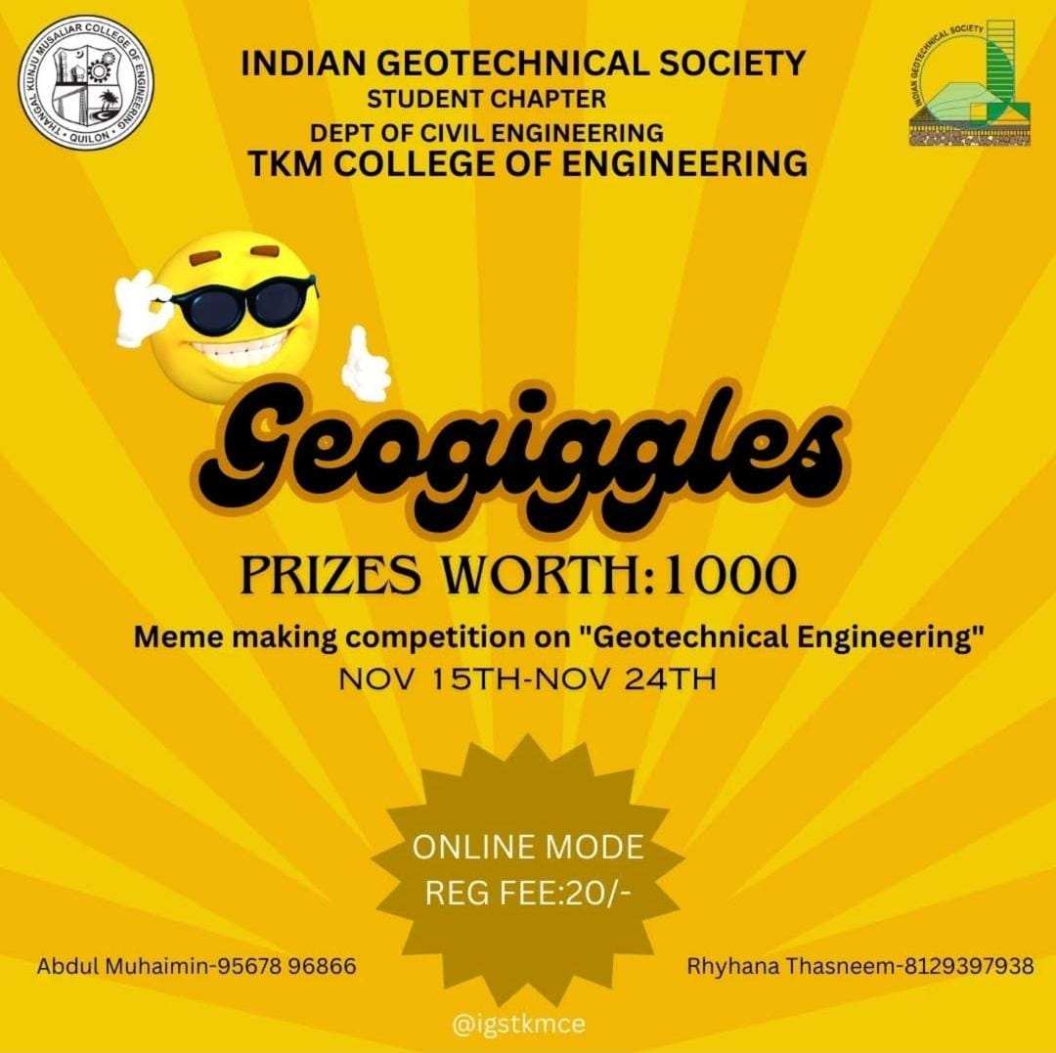
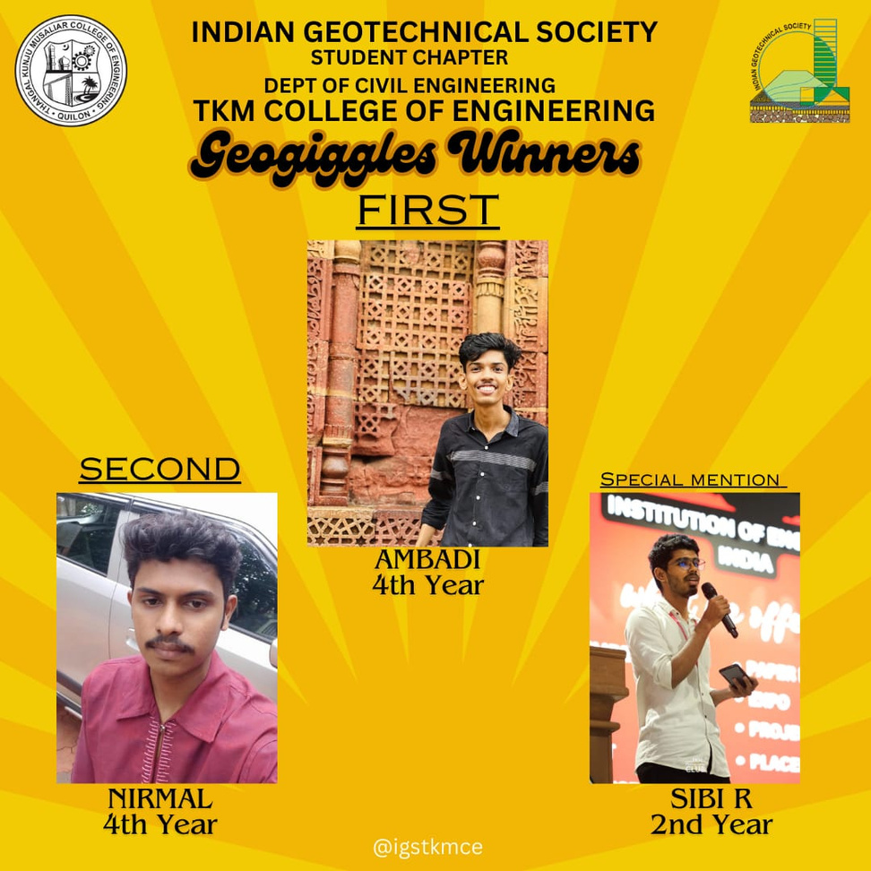
Geogiggles - Online Meme Making Competition

Slide 5

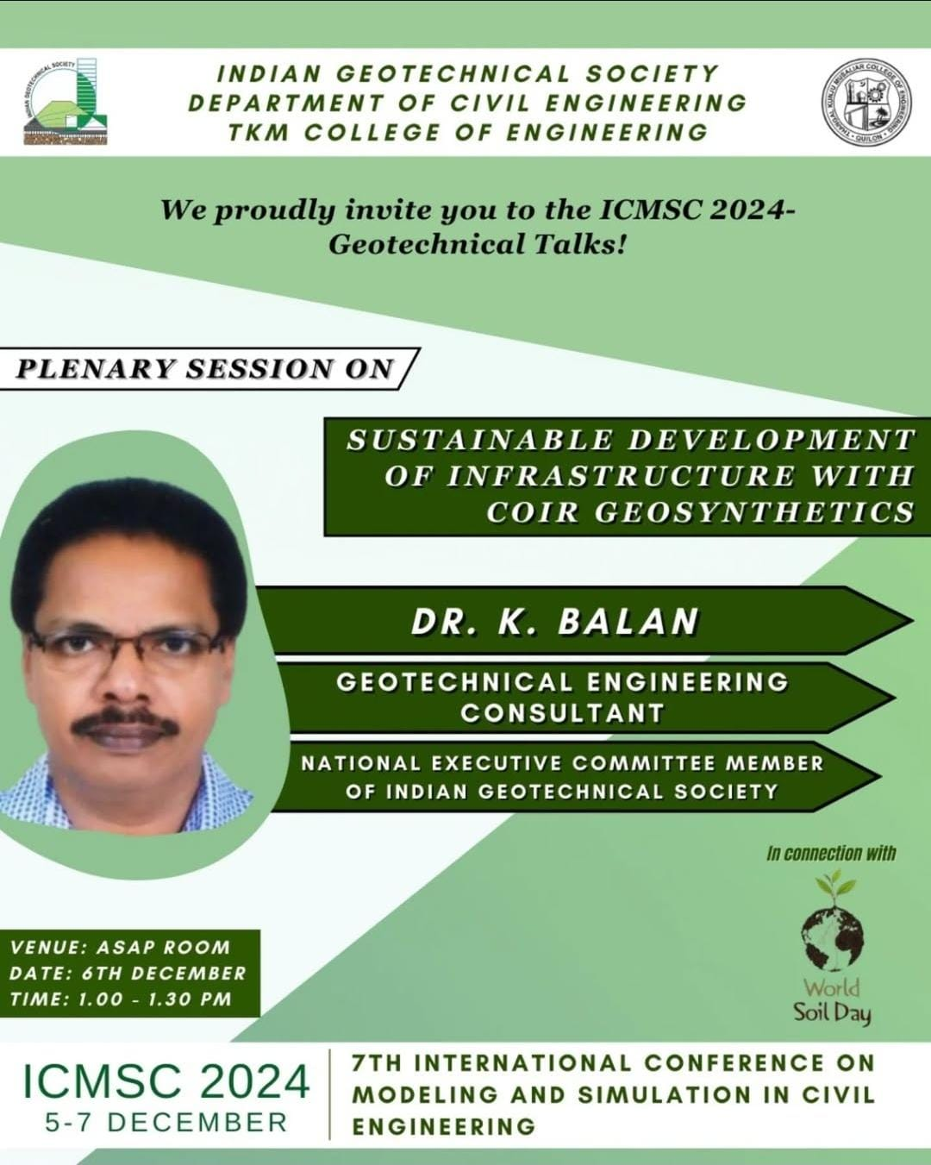
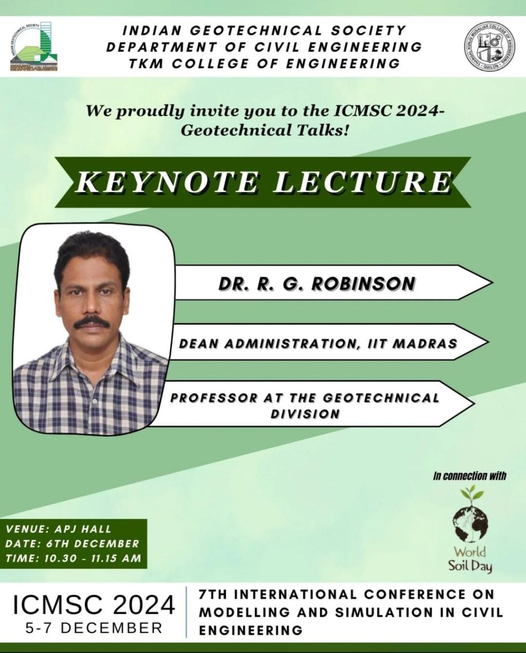
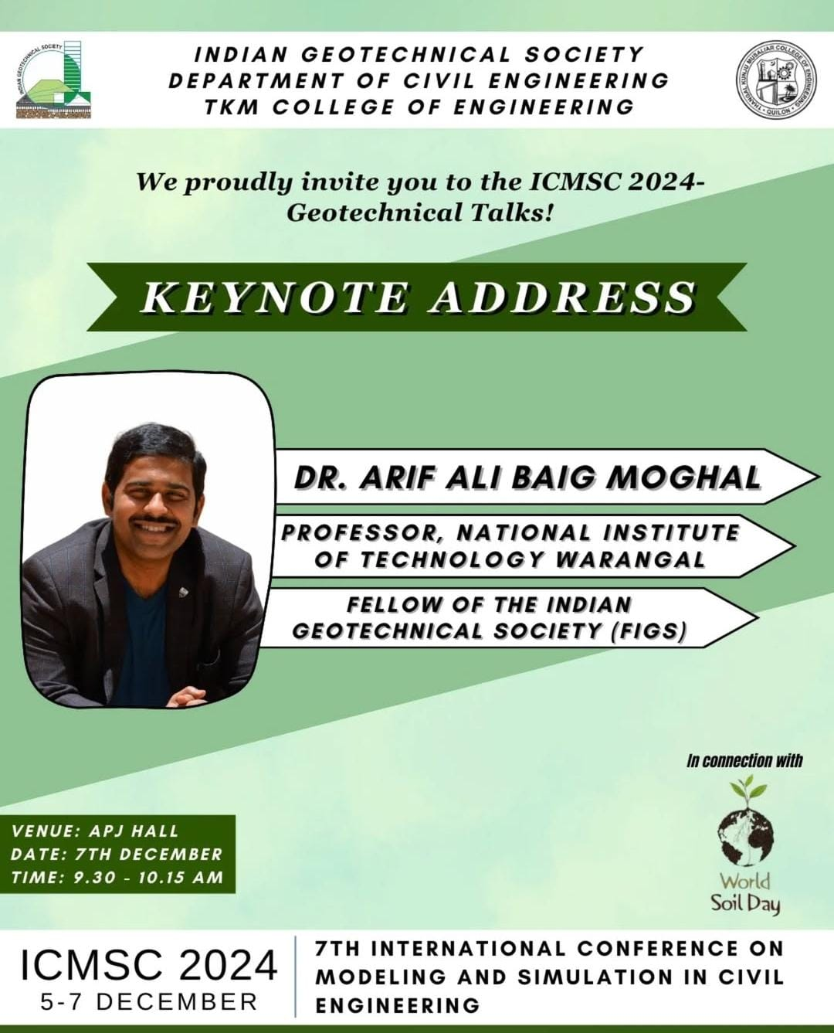
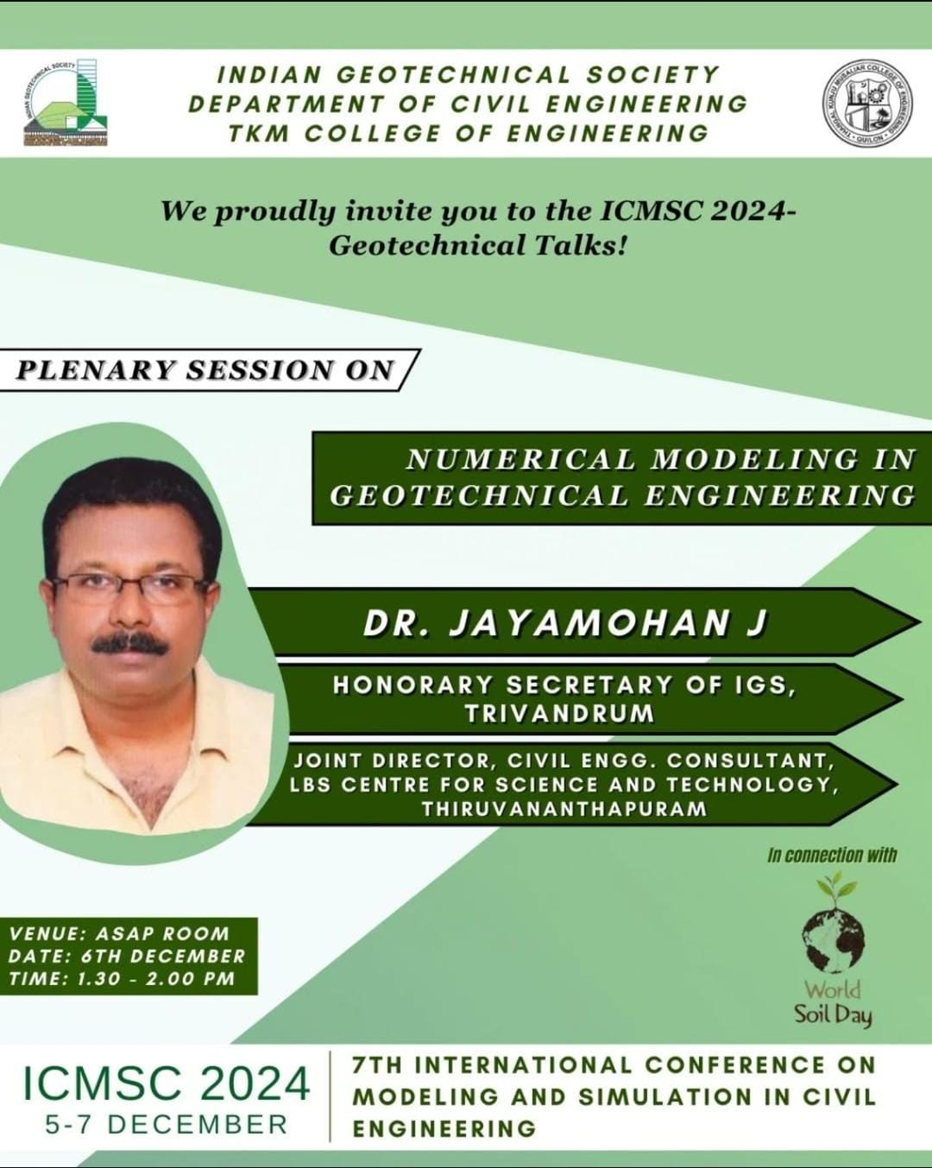
Geotechnical Talks
(In connection with World Soil Day and ICMSC 2024)

Slide 6
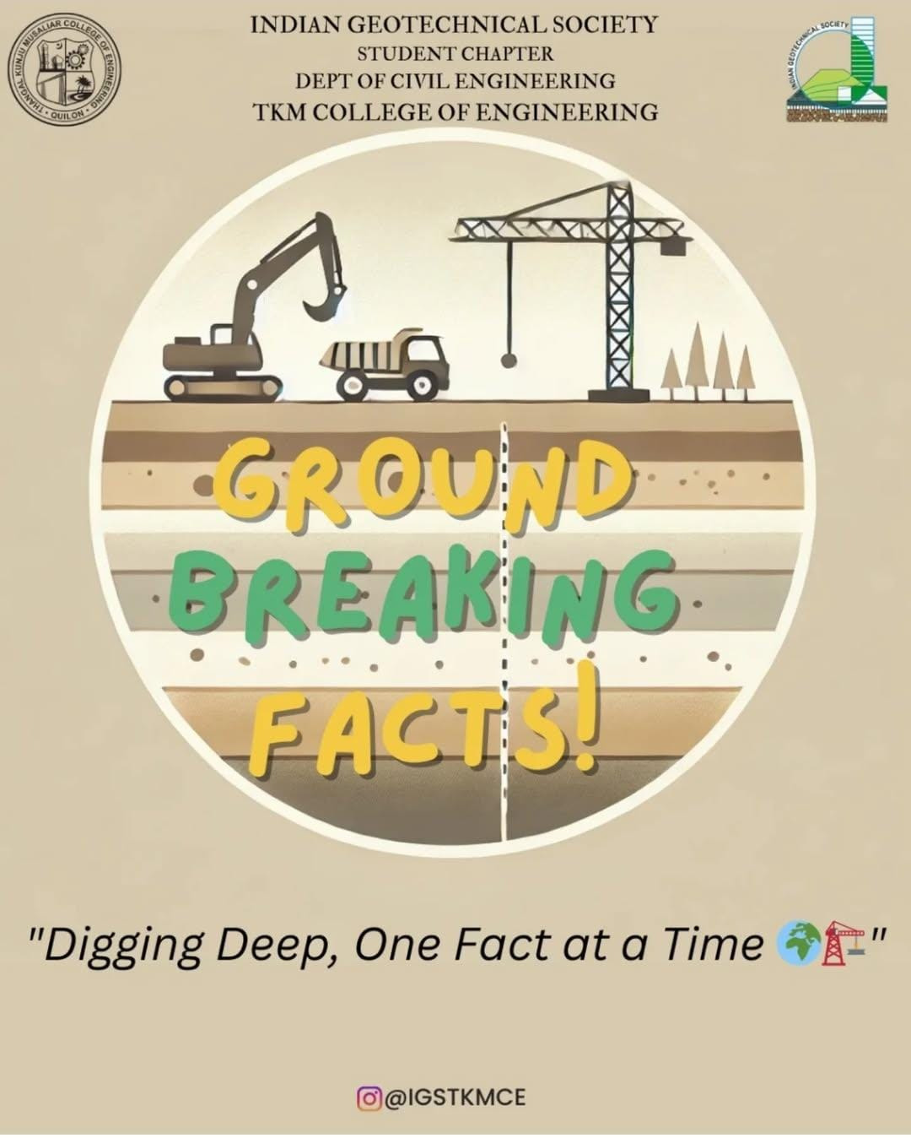
Ground Breaking Facts- Instagram Fact Series

Slide 7
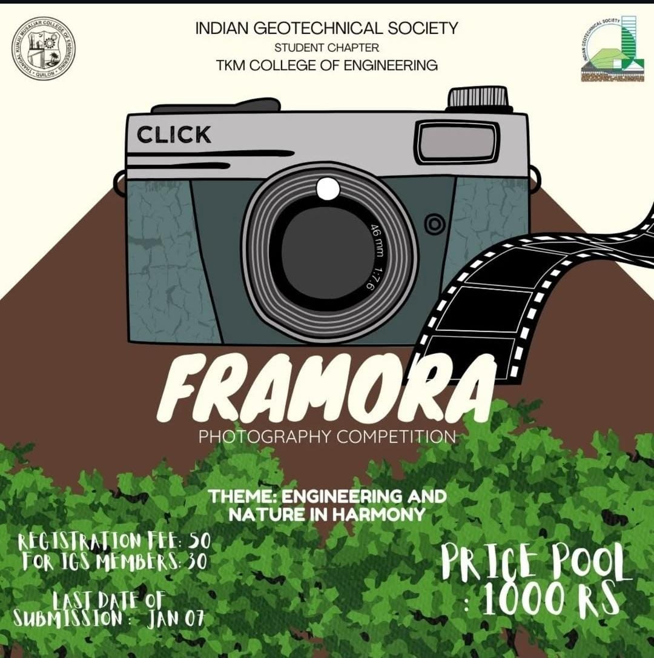
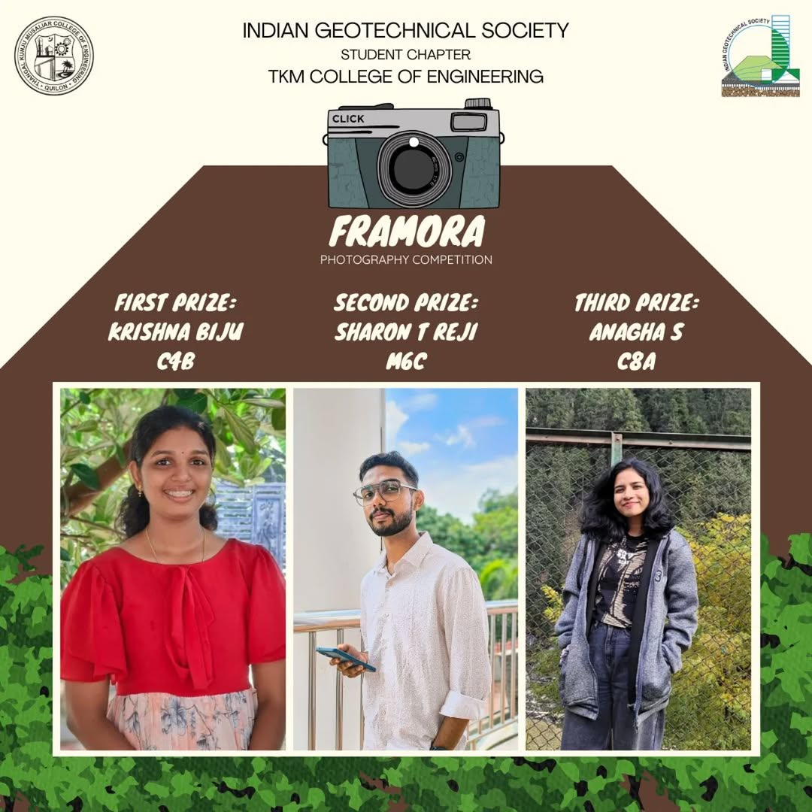
FRAMORA- Photography competition

Slide 8
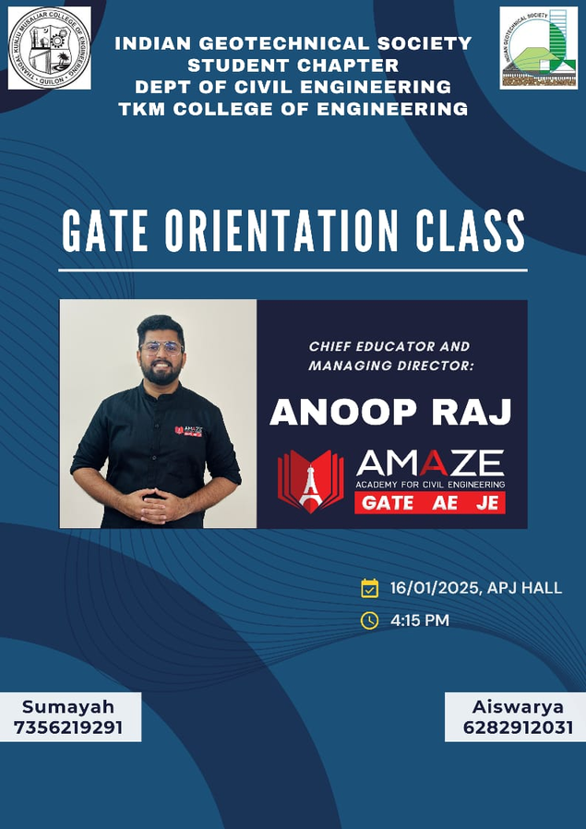

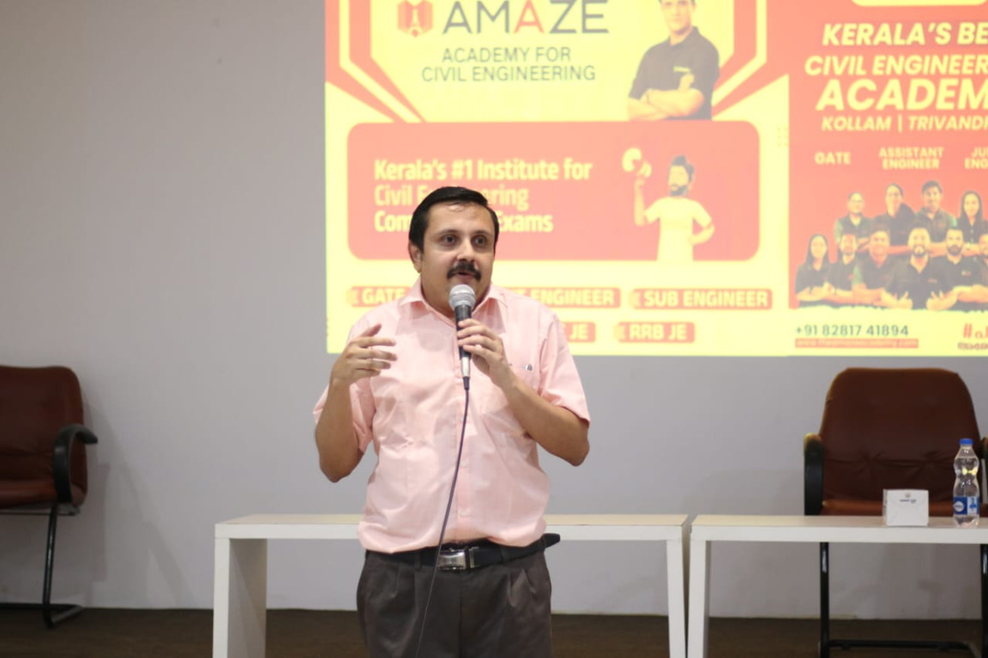
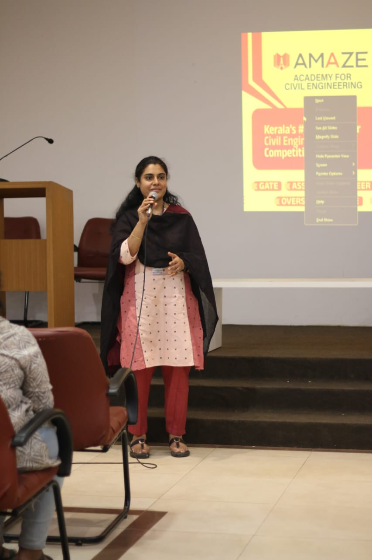
GATE ORIENTATION SESSION

Slide 9

Free GATE 2025 Coaching

Slide 10





GATE Qualifiers- IGS-Amaze Batch

Slide 11
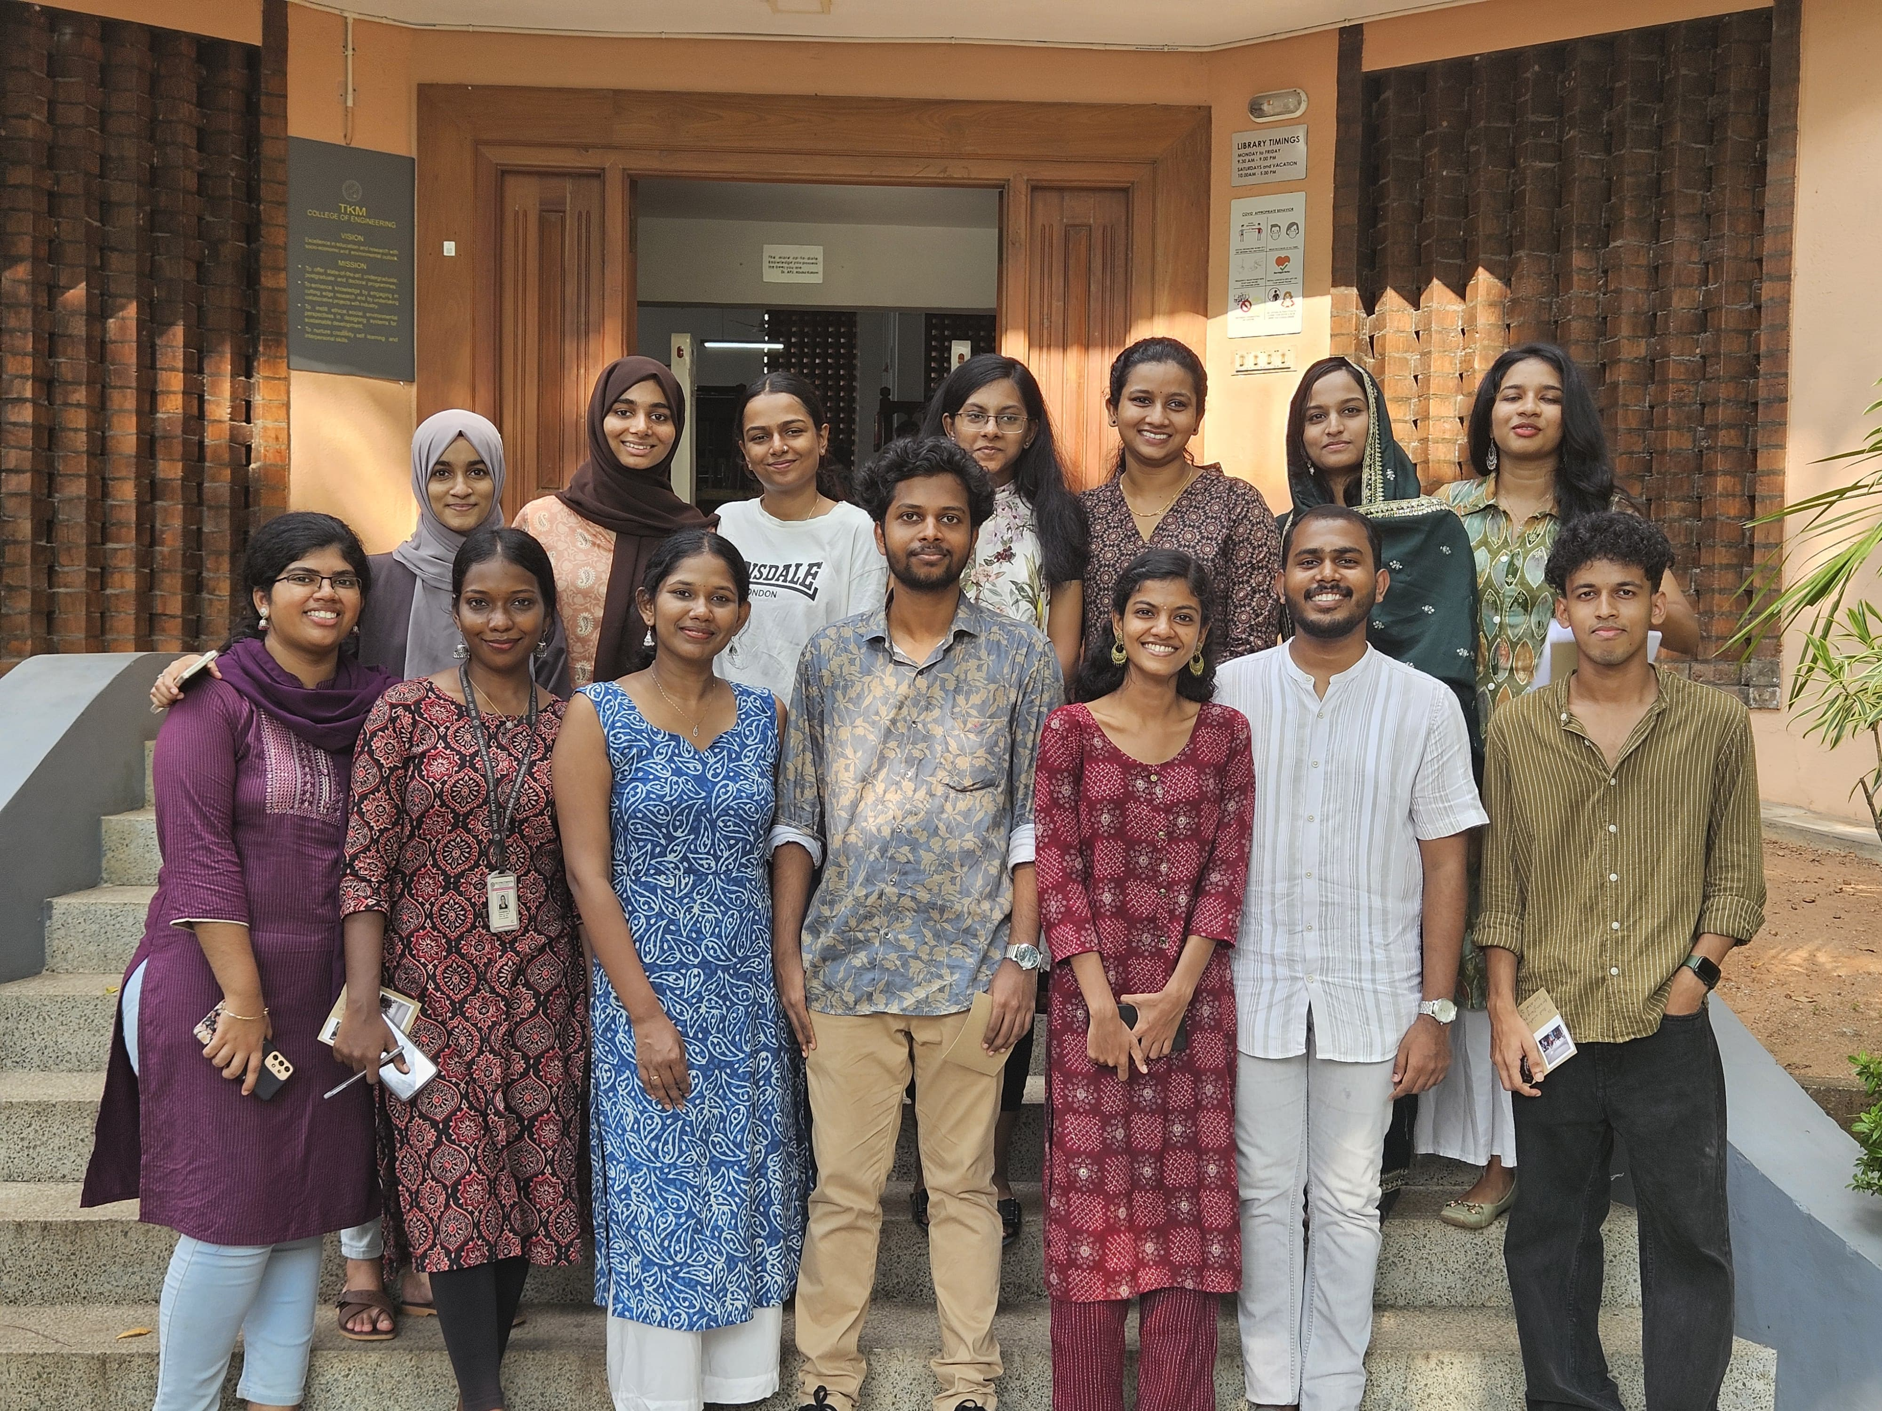
Farewell for 2025 Passout Students

Slide 12
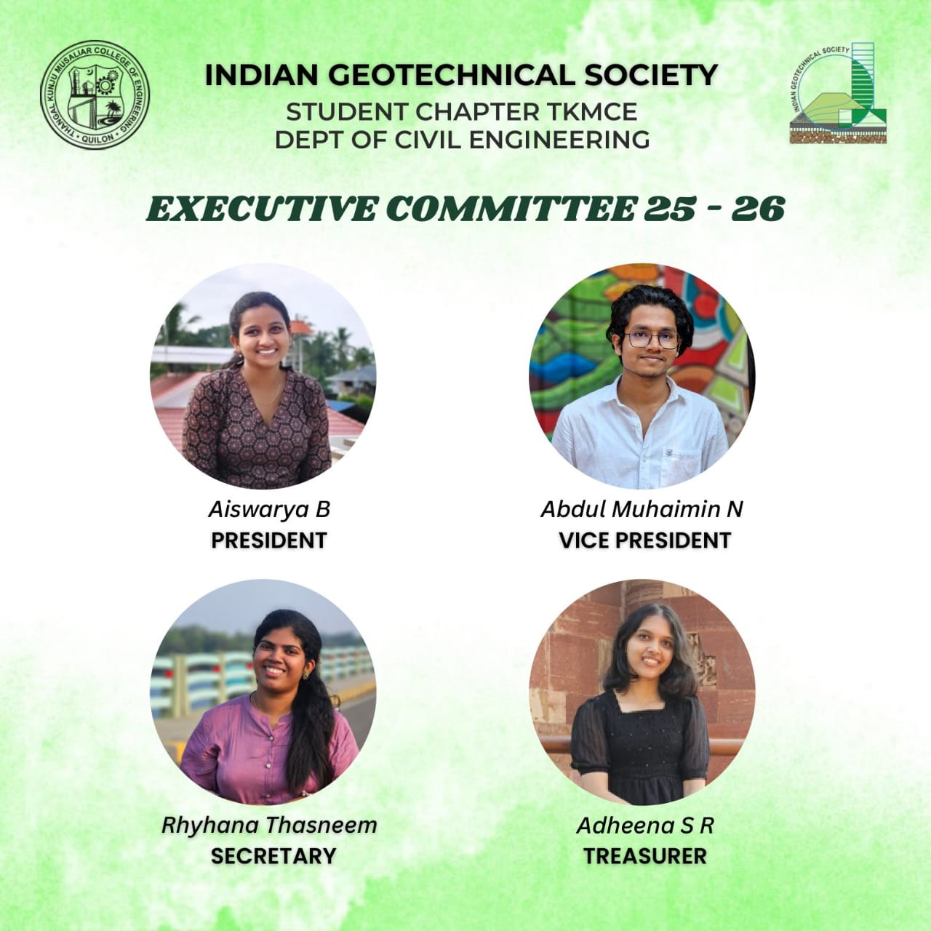
Excom 2025-26

Slide 13
THANK YOU

